Slide 1
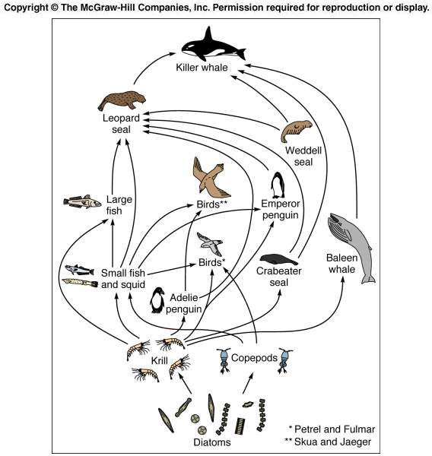
Food webs Flow of nutrients & food between different groups
What is at the base of this food web?
What is at the top of this food web?
What might happen if baleen whales went extinct?
What is missing in this food web?

Slide 2
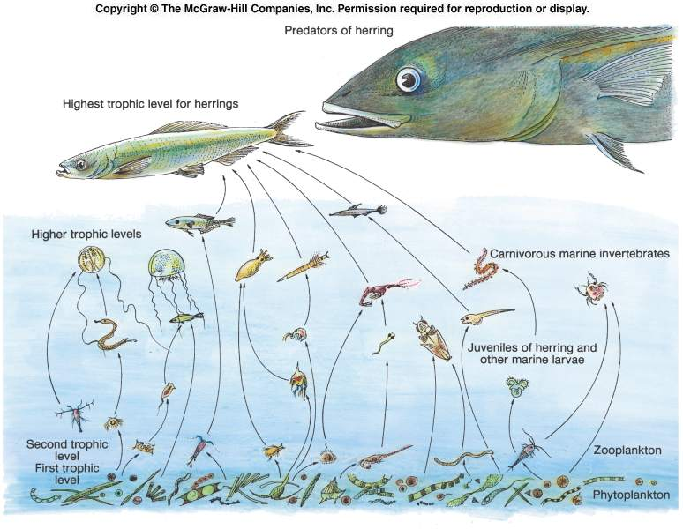
Trophic levels
Nutrients, organic matter, and energy move through food chains
Trophic levels establish the links in the food chains
Have to identify feeding relationships and energy transfer pathways

Slide 3
Biomass
Biomass decreases moving from the first trophic level with the primary producers up to higher trophic levels
Why does biomass decrease moving through a food chain?
We may add 1 kg of weight after eating 10 kg of fish; why don’t we gain exactly 10 kg?

Slide 4
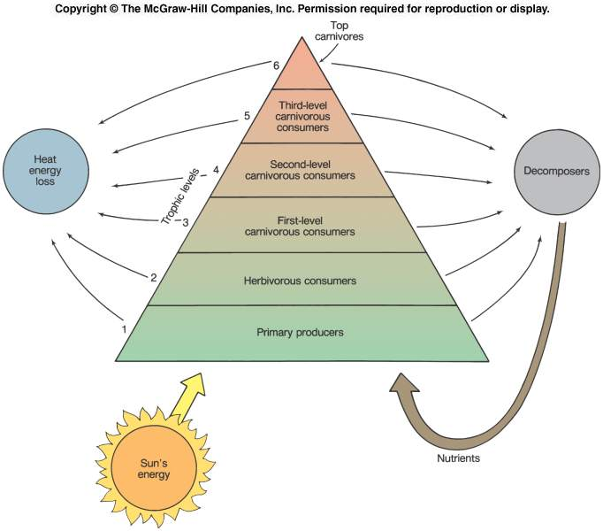
Trophic pyramid
Trophic pyramid tracks the levels in a food chain
Primary producers are at the base of the trophic pyramid
Going up a trophic pyramid:
Biomass decreases
Energy is lost
Nutrients are recycled

Slide 5
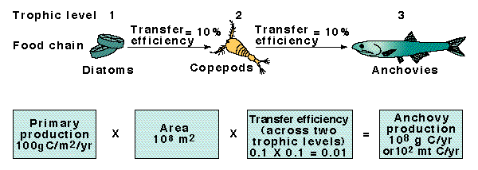
Trophic efficiency
Trophic efficiency measures how much energy and mass is transferred to each successive level
For this simple food chain example:
Phytoplankton (diatoms): 100 g C/m²/year
Zooplankton (copepods): 10 g C/m²/year
Fish (anchovies): 1 g C/m²/year

Slide 6
Trophic efficiency
Only 10% to 20% of energy and mass is transferred from one trophic level to the next
Upwelling areas are smaller in size, but have higher trophic efficiency, and fewer trophic levels than open ocean trophic pyramids
Which area will have the highest fish production?

Slide 7
Open ocean:
Primary productivity = 81% of total
Fish production = < 1% of total
Large area for increased productivity, but more trophic levels with lower transfer efficiency

Slide 8
Upwelling:
Primary production = 0.5% of total
Fish production = 50% of total
Small area, but few trophic levels, high transfer efficiency

Slide 9
Coastal food web
More trophic levels and moderate trophic efficiency (15% efficiency)
3.4 g C of herring are produced from 1000 g of phytoplankton

Slide 10
Open ocean food web
Many trophic levels and low trophic efficiency (10% efficiency)
0.1 g C of tuna produced from 1000 g C of phytoplankton
Population densities are low so more effort expended in searching for food

Slide 11
Where would you fish?

